Slide 1

Weekly report
SEJONG UNIVERSITY, SCHOOL OF MECHANICAL AND AEROSPACE ENGINEERING, SMAD LABORATORY
Doan Manh Hung

Slide 2
Working progress
Last week:
- Bending case for rectangular cross section.
This week:
- Extension case for rectangular cross section.
Next week:
- Torsion case for rectangular cross section.
SEJONG University, School of Mechanical and Aerospace Engineering, SMAD Laboratory

Slide 3
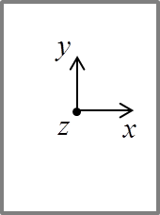
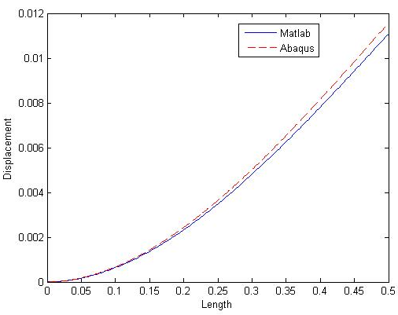
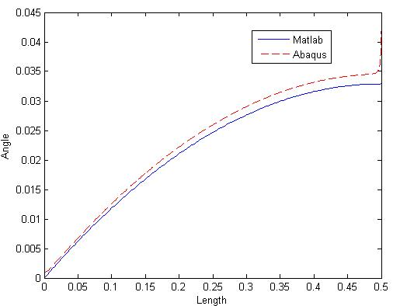











Last Week
$$Vx$$
$$βy$$
y
F_{x}
$$s_{2}$$
z
$$βy$$
$$z_{2}$$
F_{x}
$$s_{1}$$
$$z_{1}$$
$$s_{3}$$
$$z_{3}$$
$$z_{4}$$
L
Cross section
$$s_{4}$$
Case1: 2dof
SEJONG University, School of Mechanical and Aerospace Engineering, SMAD Laboratory

Slide 4
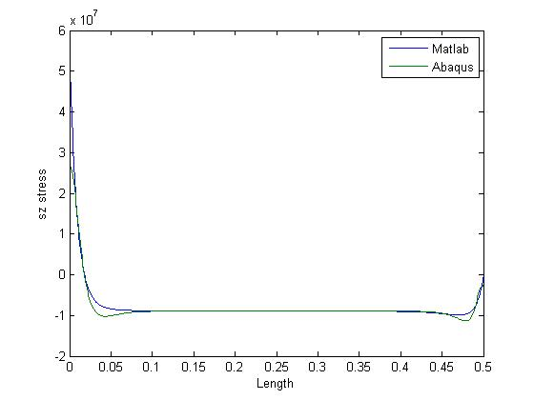
Last week
Case 1: 4dof
SEJONG University, School of Mechanical and Aerospace Engineering, SMAD Laboratory

Slide 5
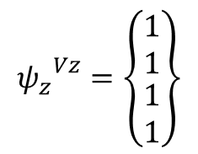
This week
Case2: 1dof
Cross section
y
x
h
z
F
b
L
$${ψ_{z}}^{Vz}=\left\{\begin{matrix}\begin{matrix}1 \\ 1\end{matrix} \\ \begin{aligned}1 \\ 1\end{aligned}\end{matrix}\right\}$$
SEJONG University, School of Mechanical and Aerospace Engineering, SMAD Laboratory

Slide 6
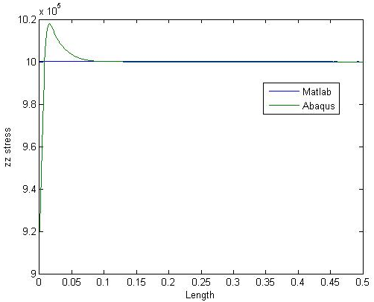
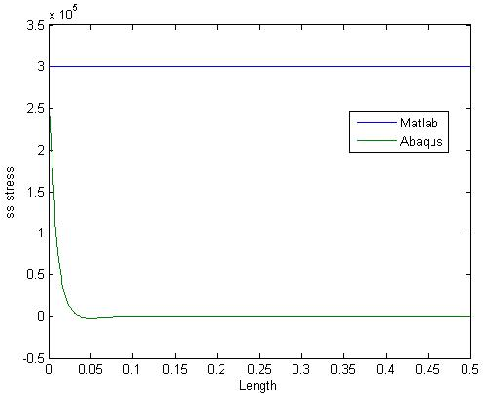
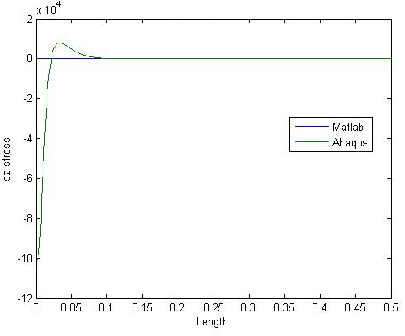
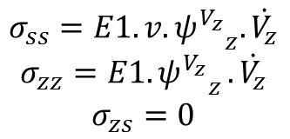
Stress results
$$σ_{ss}=E1.v.{ψ^{V_{z}}}_{z}.\dot{V_{z}}$$
$$σ_{zz}=E1{.ψ^{V_{z}}}_{z}.\dot{V_{z}}$$
$$σ_{zs}=0$$
ZZ stress
SS stress
SZ stress
Compare the plane stress result between MATLAB and ABAQUS
SEJONG University, School of Mechanical and Aerospace Engineering, SMAD Laboratory

Slide 7
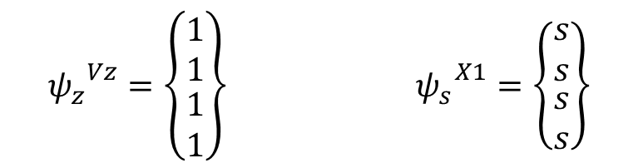


This week
Case2: 2dof
Cross section
y
x
h
z
F
b
$$Vz$$
$$X1$$
$${ψ_{z}}^{Vz}=\left\{\begin{matrix}\begin{matrix}1 \\ 1\end{matrix} \\ \begin{matrix}1 \\ 1\end{matrix}\end{matrix}\right\} {{ ψ}_{s}}^{X1}=\left\{\begin{matrix}\begin{matrix}s \\ s\end{matrix} \\ \begin{matrix}s \\ s\end{matrix}\end{matrix}\right\}$$
SEJONG University, School of Mechanical and Aerospace Engineering, SMAD Laboratory

Slide 8
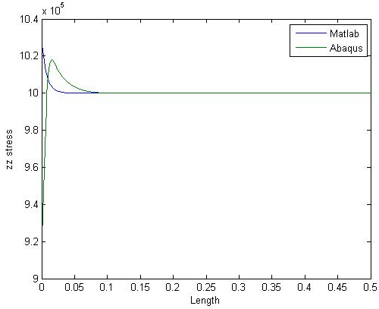
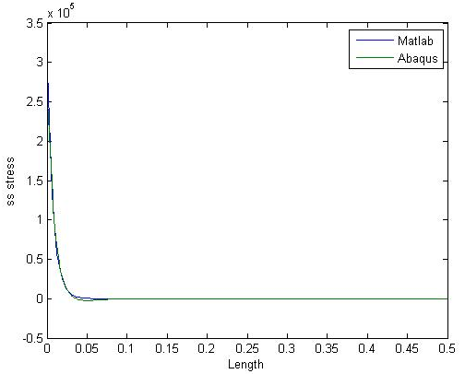
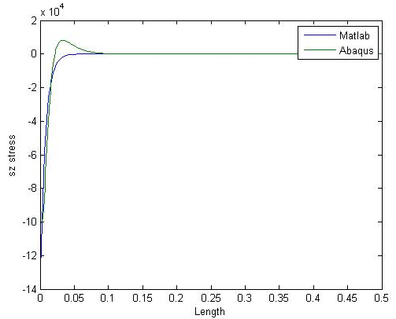
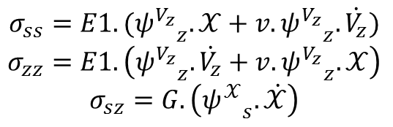
Stress results
$$σ_{ss}=E1.({ψ^{V_{z}}}_{z}.𝒳+v.{ψ^{V_{z}}}_{z}.\dot{V_{z}})$$
$$σ_{zz}=E1.\left({ψ^{V_{z}}}_{z}.\dot{V_{z}}+v.{ψ^{V_{z}}}_{z}.𝒳\right)$$
$$σ_{sz}=G.\left({ψ^{𝒳}}_{s}. \dot{𝒳}\right)$$
ZZ stress
SS stress
SZ stress
Compare the plane stress result between MATLAB and ABAQUS
SEJONG University, School of Mechanical and Aerospace Engineering, SMAD Laboratory

Slide 9



This week
Case2: 3dof
Cross section
y
x
z
F
h
b
$$Vz$$
$$X1$$
$$W1$$
SEJONG University, School of Mechanical and Aerospace Engineering, SMAD Laboratory

Slide 10
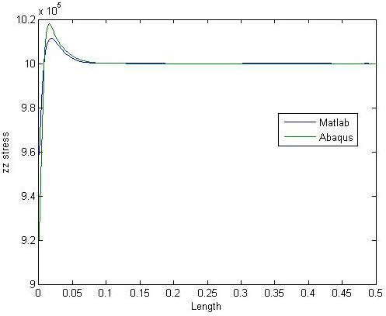
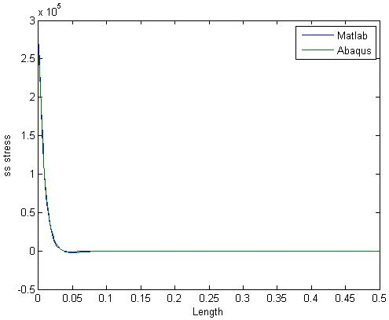
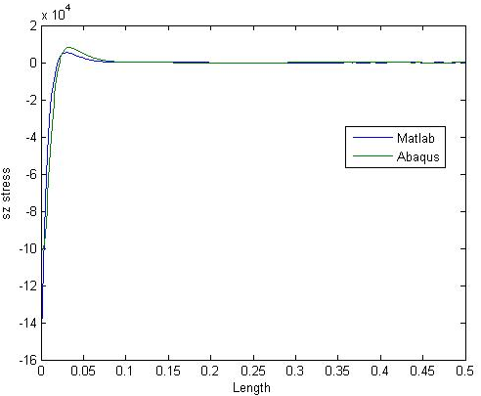
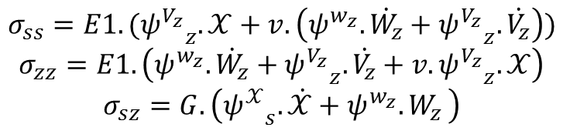
Stress results
$$σ_{ss}=E1.({ψ^{V_{z}}}_{z}.𝒳+v.\left({ψ^{w_{z}}.\dot{W_{z}}+ψ^{V_{z}}}_{z}.\dot{V_{z}}\right))$$
$$σ_{zz}=E1.\left({ψ^{w_{z}}.\dot{W_{z}}+ψ^{V_{z}}}_{z}.\dot{V_{z}}+v.{ψ^{V_{z}}}_{z}.𝒳\right)$$
$$σ_{sz}=G.\left({ψ^{𝒳}}_{s}. \dot{𝒳}+ψ^{w_{z}}{.W}_{z}\right)$$
ZZ stress
SS stress
SZ stress
Compare the plane stress result between MATLAB and ABAQUS
SEJONG University, School of Mechanical and Aerospace Engineering, SMAD Laboratory

Slide 11

Next week
Case3: Torsion Case
Cross section
h
y
x
z
$$M_{z}$$
b
SEJONG University, School of Mechanical and Aerospace Engineering, SMAD Laboratory

